Slide 1



Modern Workplace design
Walter Fraser

Slide 2
[~]whoami: airwalkreply\walterfraser
I’ve been working in IT since before virtualisation was a thing (explains the lack of hair)
Majority of my career in IT as an engineer and solution architect
Switched focus to Office/Microsoft 365 from 2014 onwards
Experienced in designing and maintaining highly regulated/complex environments
Gaffers: Airwalk reply – Senior Architect

Slide 3
Where to begin?
Developing a modern workplace design can be a daunting task, there are many things to consider:
Business benefits
Governance
Security
Cost
Scalability
Manageability

Slide 4
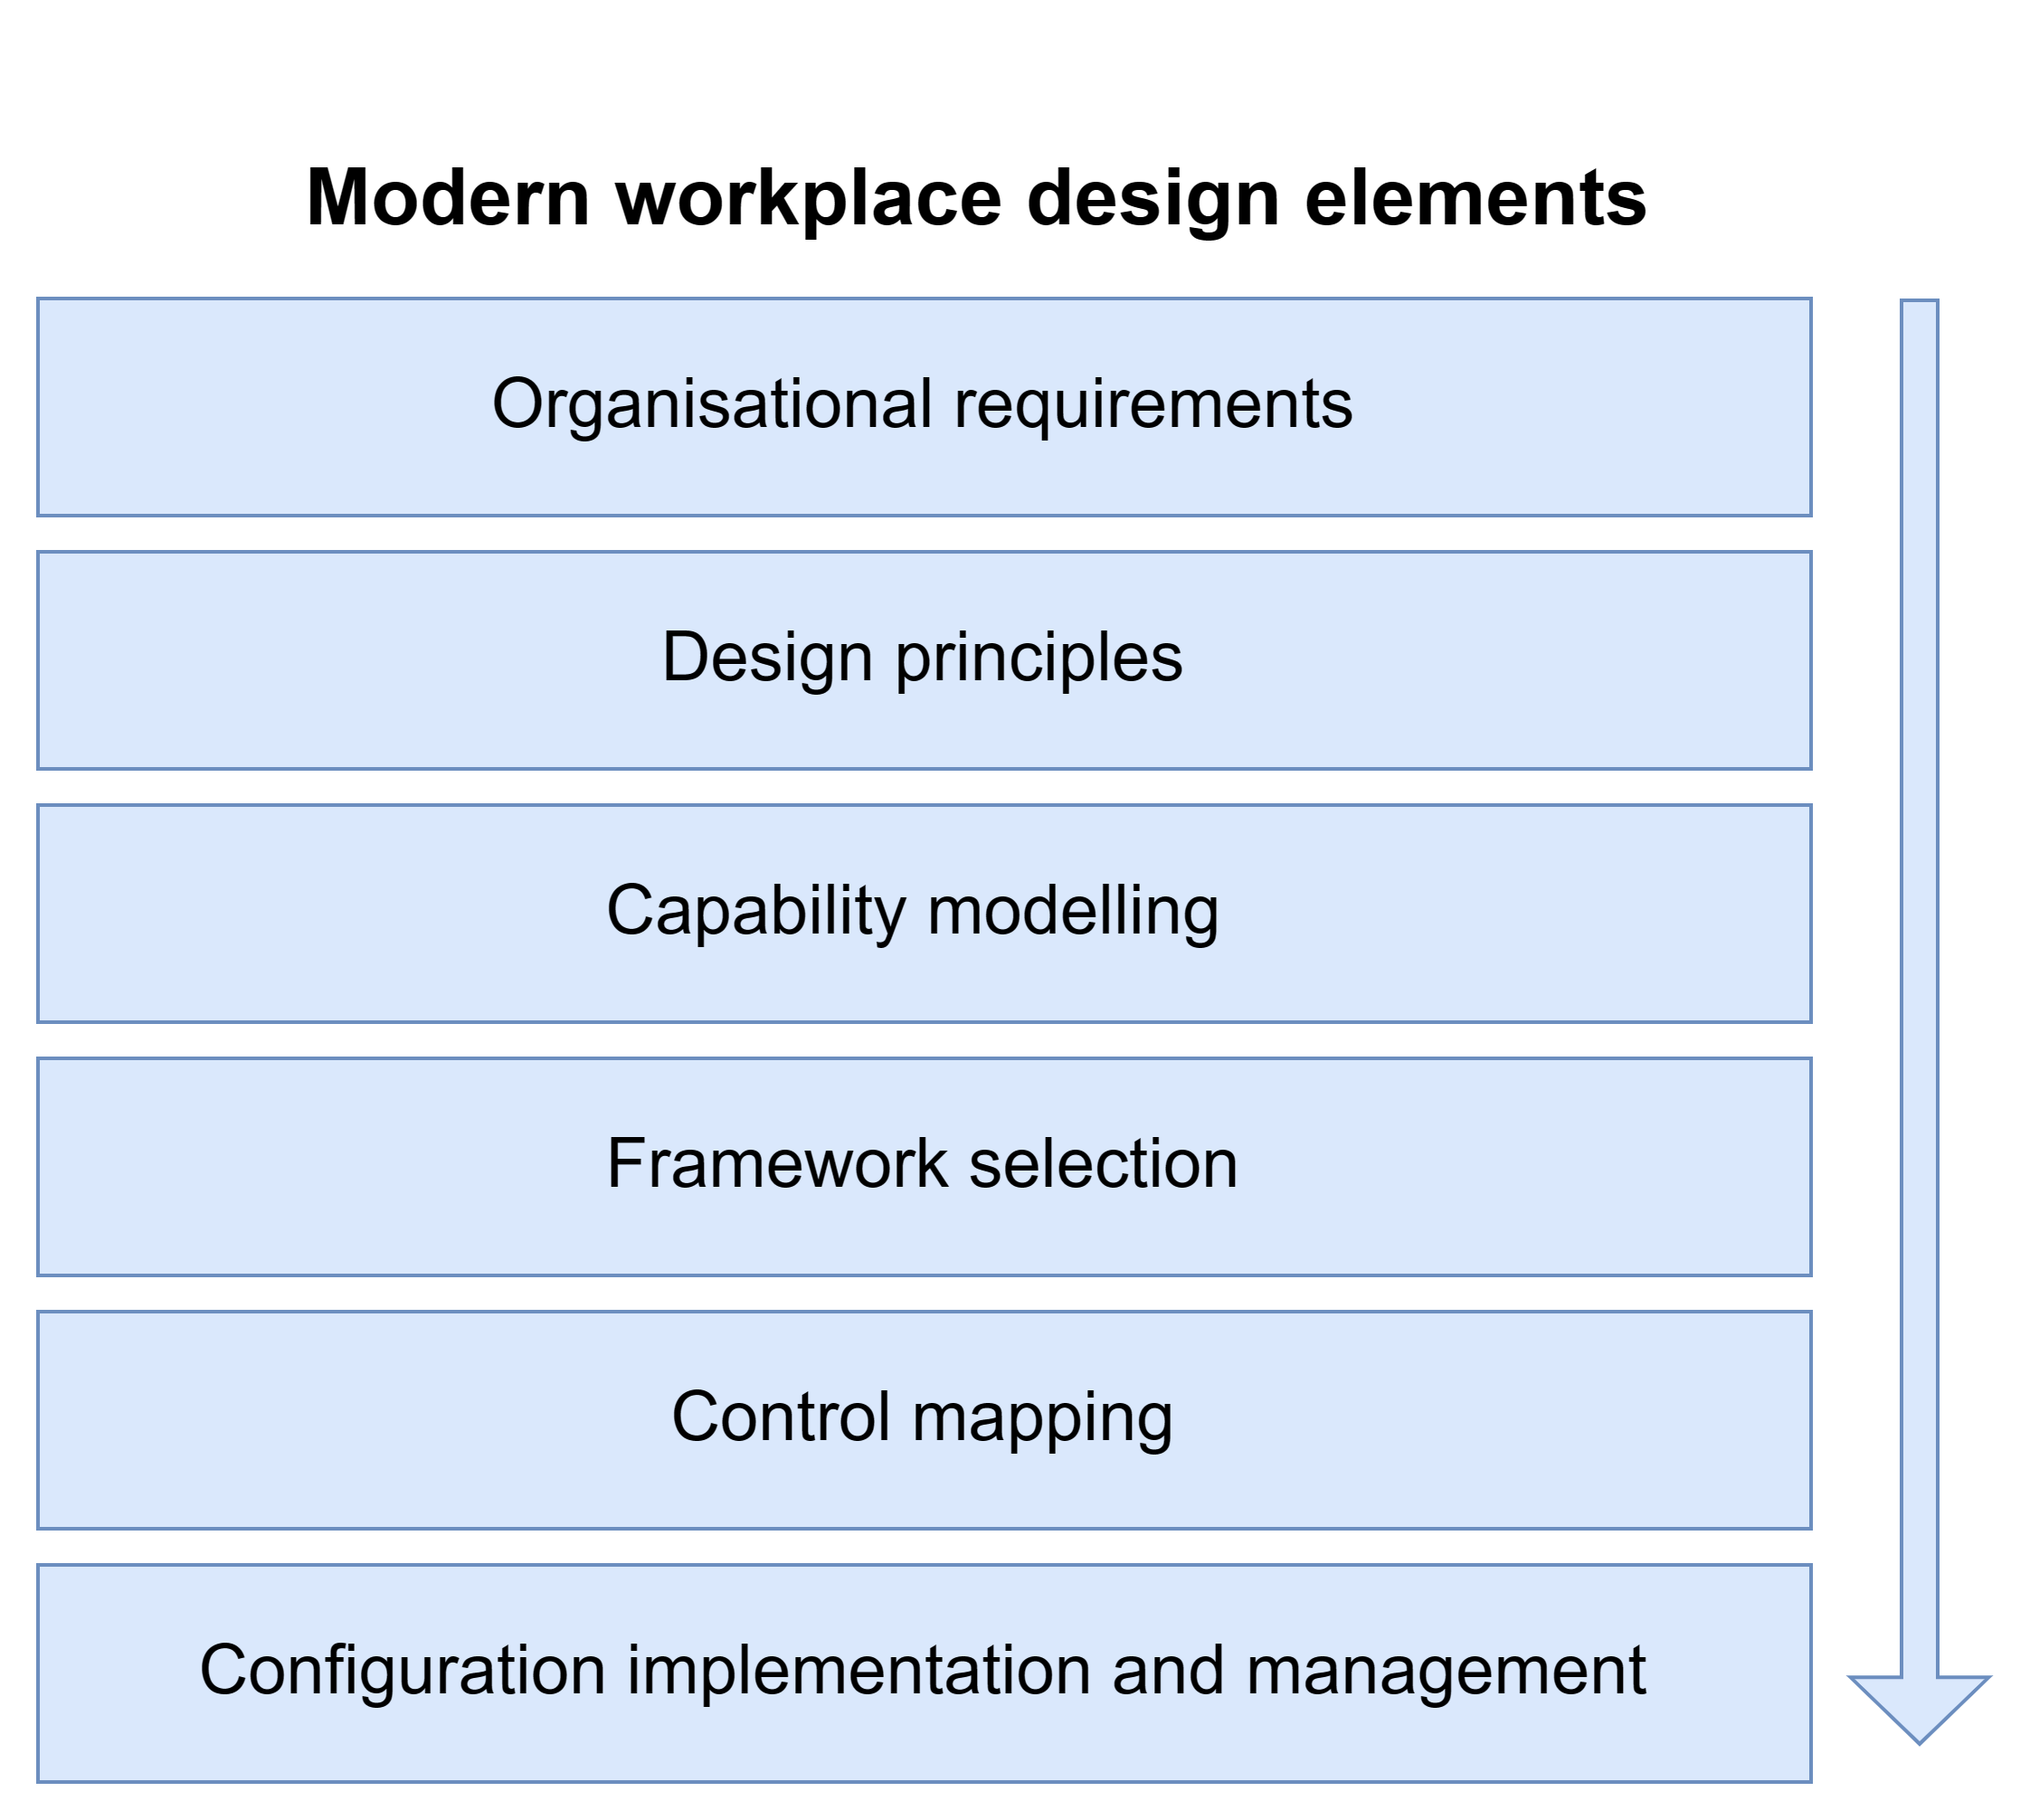
A layered approach to design

Slide 5
Identify your organisational requirements
To identify the organizational requirements for the modern workplace design, you would first need to understand the specific needs and goals of the organization.
This could involve conducting interviews with key stakeholders, analysing existing data and processes, and conducting a thorough assessment of the organization's current technical capabilities.
It's also important to consider factors such as scalability, security, and cost when identifying requirements for the design.
Once you understand the organization's needs and goals, identify the requirements for the compute design, such as computing power, software, and specialized requirements.
Notes:
Once you have a clear understanding of the organization's needs and goals, you can then begin to identify specific requirements for the compute design, such as the type and amount of computing power needed, the type of software and applications that will be used, and any other specialized requirements that may be necessary

Slide 6
Here are some examples of specific requirements that might be included in a design for a typical modern workplace project:
A high-performance computing infrastructure that can support a large number of users and a wide range of applications, including data-intensive and real-time workloads.
A flexible and scalable design that can accommodate future growth and changes in technology and business needs.
Support for remote and mobile access, including secure access to data and applications from a variety of devices and locations.

Slide 7
Integration with other systems and technologies, such as collaboration and communication tools, cloud-based services, and data analytics platforms.
Robust security measures to protect against cyber threats and data breaches.
Energy-efficient design and environmentally-friendly technology solutions to support the organization's sustainability goals.
Cost-effective solutions that provide a good return on investment and support the organization's budget constraints.

Slide 8
Design principles
Design principles ensure consistent, reliable, and effective design. They provide guidelines, ensure end-user needs are met, and ensure scalability and flexibility. Establishing them early saves time and ensures high quality.
A single operating system and build simplifies management and maintenance.
Adopting as newer and modern a platform as the organisation can reasonably be expected to adopt.
A defined core operating environment – define a set of applications and tools that everyone should have access to as standard.
Notes:
Establishing design principles in an end-use compute design is important because it helps to ensure that the design is consistent, reliable, and effective.
Design principles provide a set of guidelines that you can follow when creating a system, and they help to ensure that the system will meet the needs of the end-users. Additionally, design principles can help to ensure that the system is easy to use and maintain, and that it is scalable and flexible enough to accommodate future changes and growth.
By establishing design principles early on in the design process, designers can save time and effort by avoiding the need to make changes later on, and they can help to ensure that the end product is of high quality.

Slide 9
Design principles
Architectural simplification – Where applicable a ‘rule of one’ to all software solutions e.g., one video conference solution, one chat tool. Drive standardisation over perceived edge cases.
Simplify offerings – ensure that the future product selection is as small as possible whilst still meeting the business needs, e.g., one virtual desktop, one high powered workstation, one desktop, one laptop standard and one high end, one corporate smartphone standard and high end.
Streamlined request management – allow the deployment of all requested software in an automated fashion once business approval is given. Any software not used for 45 days is then removed automatically.
Increased optionality supporting ‘Bring Your Own Device’ and the use of personal tech – Support the use of employee’s own device and, where regulation allows, actively encourage it by providing ancillary services such as increased connectivity and remote access options.

Slide 10
Creating a capability model
A modern workplace technical capability model is a methodology that is used to assess and evaluate the current state of an organization's technology and systems, with the goal of identifying areas for improvement and growth. This model typically includes several key components, including:
A set of criteria used to evaluate an organization's technical capabilities, including automation, integration, use of cloud technologies, and ability to support remote and flexible work.
A set of levels reflecting an organization's technical capability and readiness for modern technologies, such as "legacy", "evolving", "transforming", and "innovative".
A set of recommendations to help an organization advance its technical capability, such as upgrading systems, implementing new technologies, and investing in training.
Overall, a modern workplace technical capability model provides a structured and objective way to assess and improve the organization's technology and systems, enabling it to better support the needs of a modern and flexible workplace.

Slide 11
Organisational requirements and technical capabilities
Measuring organizational requirements against a technical capability model helps ensure the compute design meets the organization's needs and goals, identifies gaps and weaknesses, and provides a benchmark for assessing the impact on performance.
Notes:
Measuring organizational requirements against a technical capability model can help to ensure that the compute design being developed will meet the specific needs and goals of the organization.
By comparing the organization's requirements to the technical capabilities outlined in the model, you can identify any gaps or weaknesses that may need to be addressed in the design, as well as any areas where the organization may be over- or under-investing in certain technologies or capabilities.
This can help to ensure that the compute design is tailored to the organization's specific needs and will support its operations effectively.
Additionally, measuring organizational requirements against a technical capability model can provide a useful benchmark for assessing the potential impact of the compute design on the organization's overall performance.

Slide 12
Examples of a capability model
Each model represents three ‘tiers’ of capability:
Foundational
Intermediate
Managed
While working inside to outside makes sense, some requirements which may be a priority could exist on the outside. A model can be used as a tool to identify pre-requisites before deploying components.

Slide 13
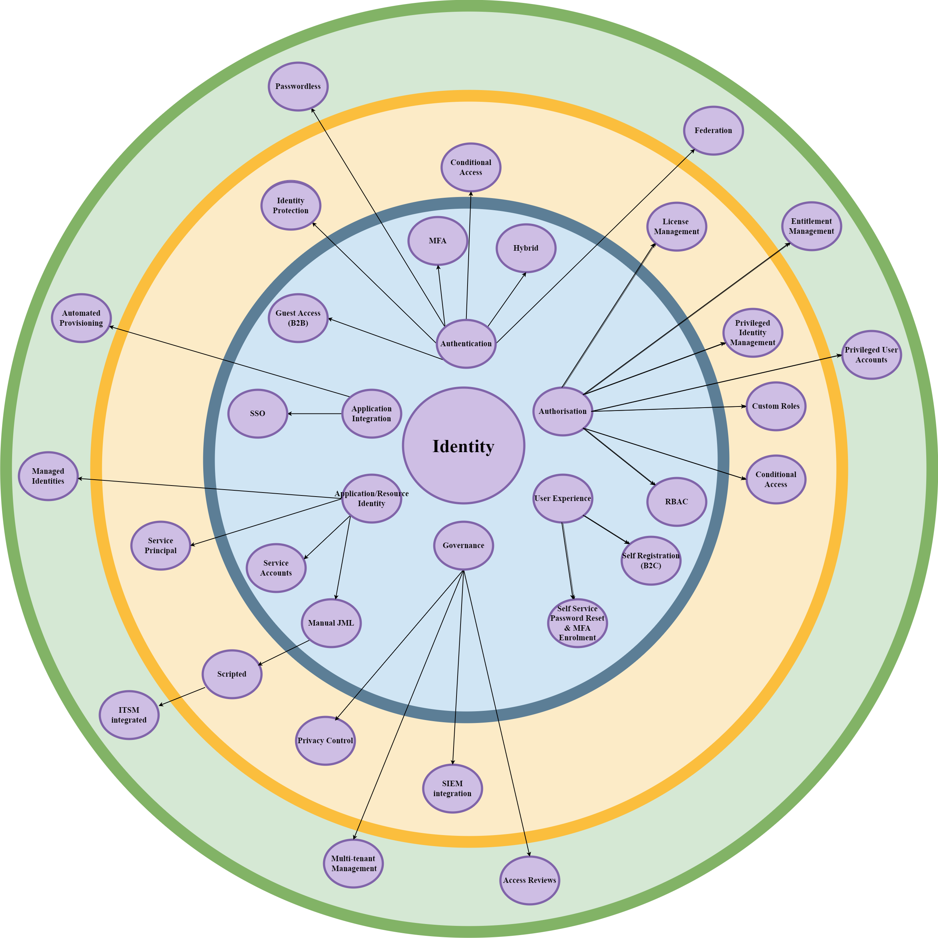
Example: Modern Identity capability model
This model represents the function and feature of foundational through to managed levels of configuration which is achievable within the Microsoft 365 Tenant.
The capability going from centre out shows the core components which should be in place, easiest to implement with the least impact being central to the core technology, hardest with significant impact or effort being on the outside.

Slide 14
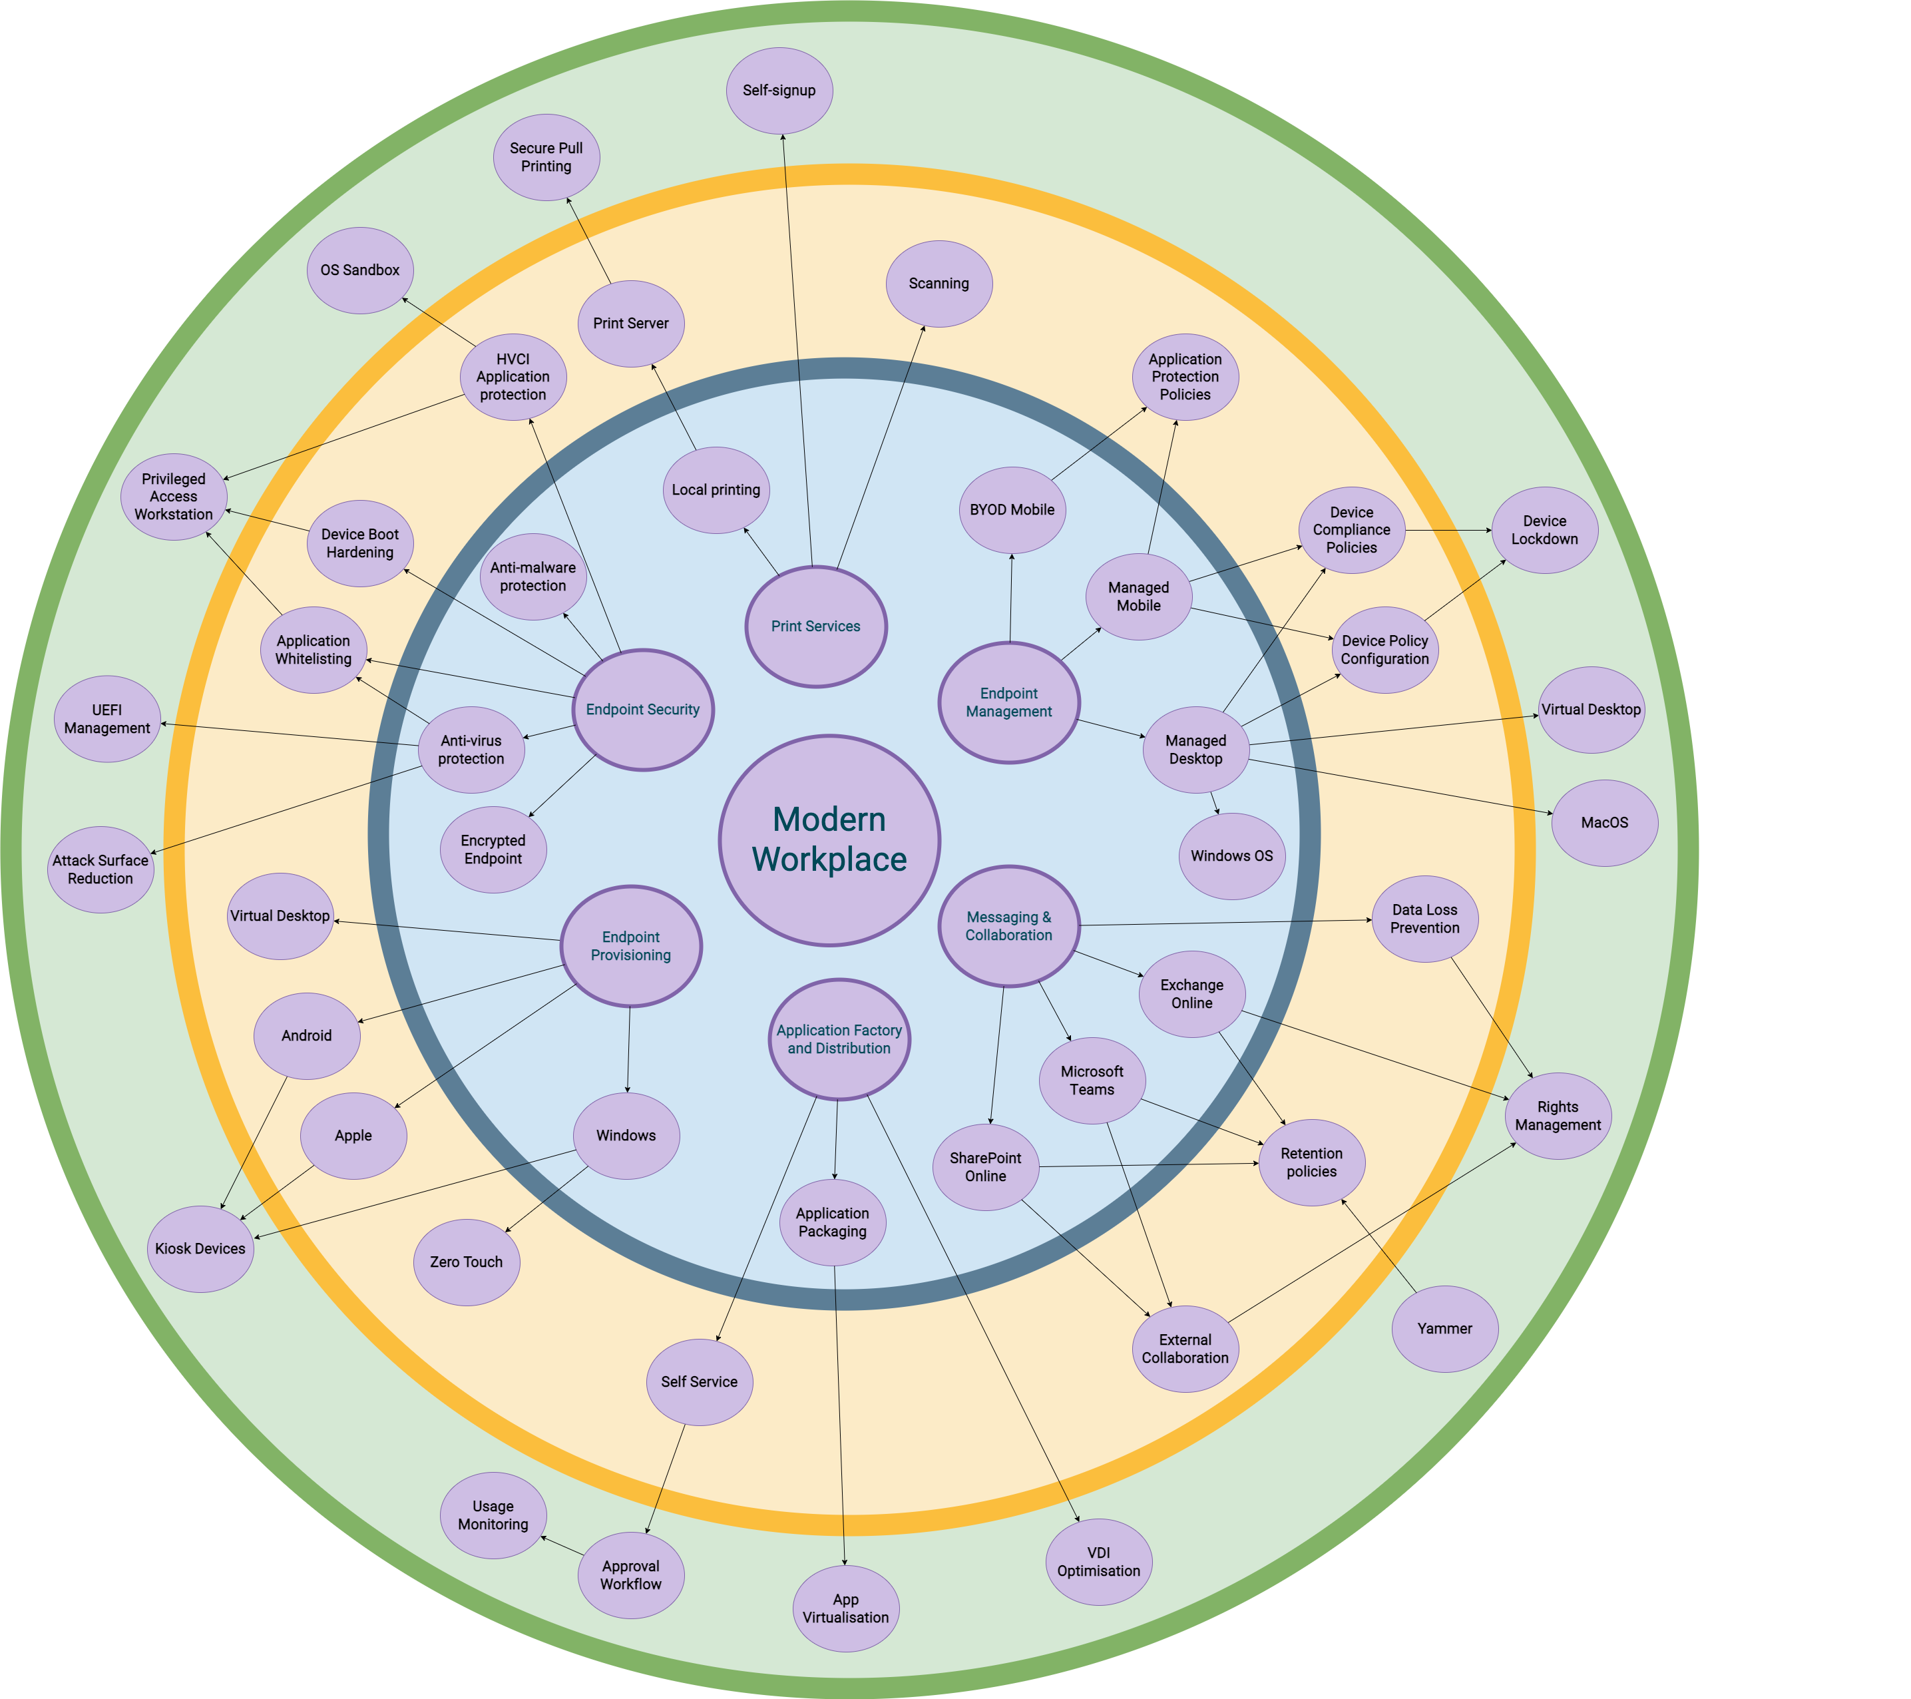
Example: Modern workplace capability model
This model represents the function and feature of foundational through to managed levels of configuration which is achievable within the Microsoft 365 Tenant.
The capability going from centre out shows the core components which should be in place, easiest to implement with the least impact being central to the core technology, hardest with significant impact or effort being on the outside.

Slide 15
Filling the gaps
A capability model is a tool that can be used to help organizations understand and analyse their capabilities, or the ability of their systems and processes to perform certain tasks or functions.
This analysis can then be used to identify gaps in an organization's capabilities and to develop or choose a technical framework that can be used to address those gaps.
Your capability will improve over time but creating a capability model and choosing an established framework will help ensure that you always have a baseline to operate from, this will help you understand future impacts your changes have to your organisational environments.

Slide 16
What is a framework?
A framework is a set of guidelines, tools, and good practices that can be used to build a secure end-use compute design. Choosing a framework provides several benefits, including:
Standardized approach: A framework provides a standardized approach to design and implementation, which ensures that all aspects of the design are consistent and aligned with industry good practices.
Well-defined processes: A framework includes well-defined processes for identifying, assessing, and mitigating security risks, which helps to ensure that the design is robust and secure.
Comprehensive guidance: A framework provides comprehensive guidance on how to design and implement secure end-use compute systems, including guidance on security controls, architecture, and testing.
Ongoing support: A framework typically includes ongoing support and updates, which ensures that the design remains current and effective in the face of changing security threats and technologies.
Overall, choosing a framework to build a secure end-use compute design provides a structured, comprehensive, and well-supported approach that can help to ensure that the design is effective and resilient against security threats.

Slide 17
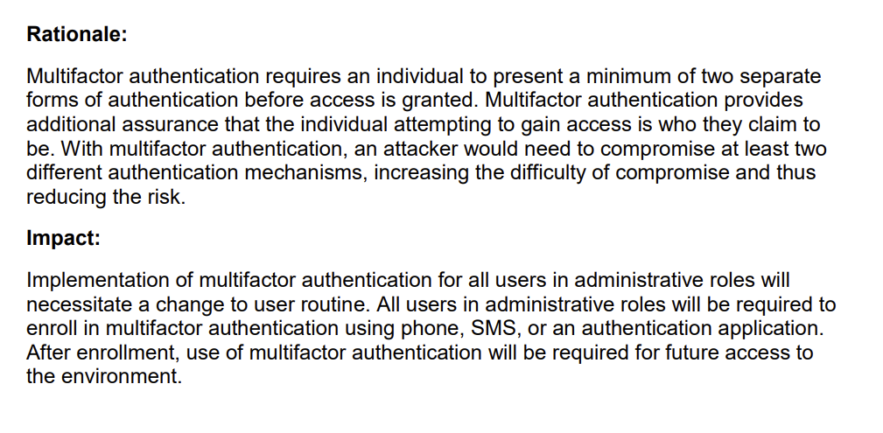
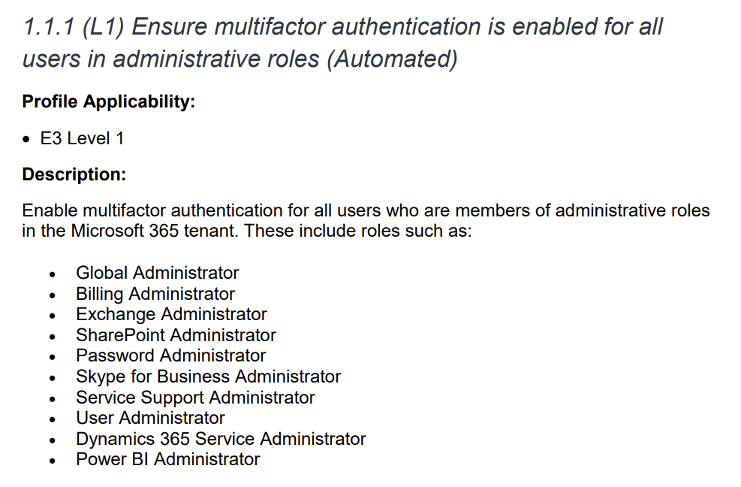
Framework components
Each recommendation contains several sections, including a recommendation identification number, title, and description; level or profile applicability; rationale; instructions for auditing the control; remediation steps; impact of implementing the control; default value; and references.
There are similar controls within NIST/NCSC, so a framework should be selected to ensure that established guidelines are adhered to on acceptable good practices

Slide 18
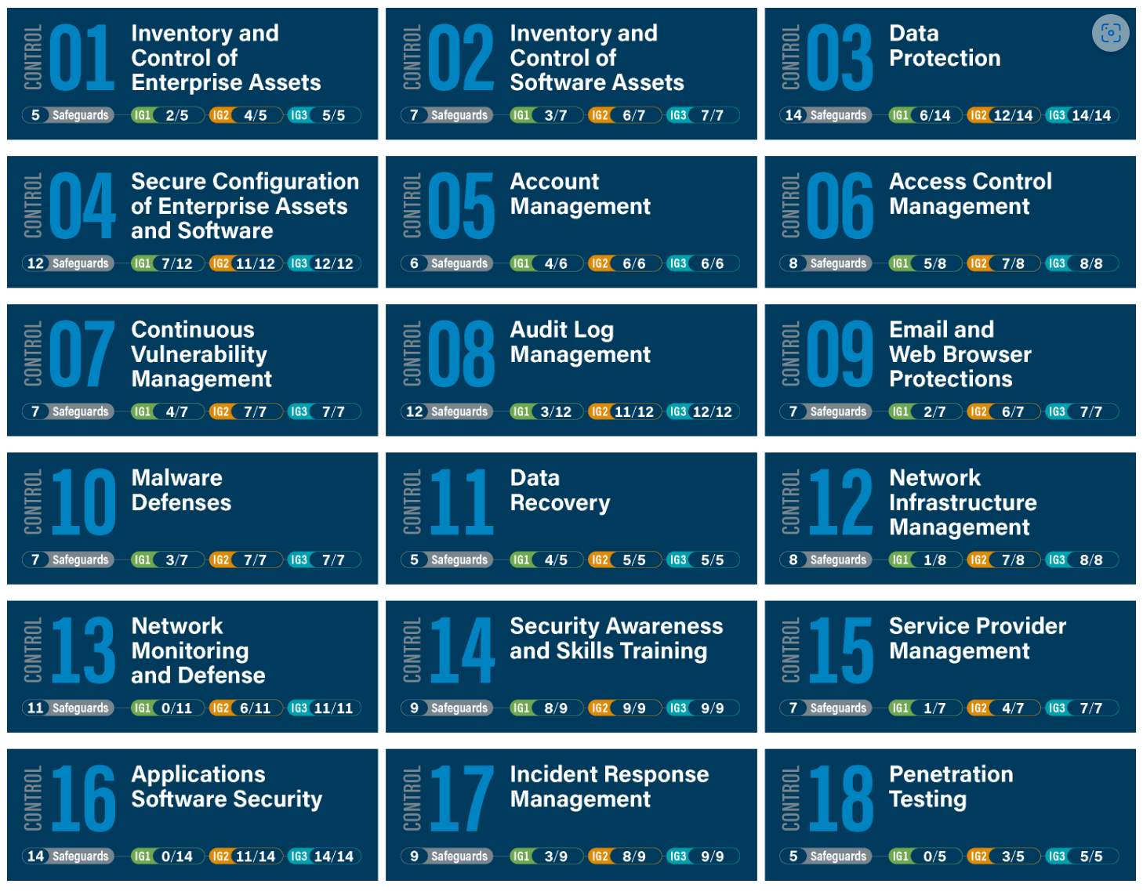
Example framework: CIS critical security controls v8
The CIS Microsoft 365 v1.5 benchmark is derived from a larger set of controls called the CIS critical security controls V8, these additional set of controls focus on developing the configuration capability of organisations with a set of basic, foundational and organisational level of additional controls.
Correct implementation of all 18 of the controls greatly reduces security risk, lowers operational costs, and improves any organization’s defensive posture. However, as you likely know, simply being compliant is not enough to entirely mitigate attacks and protect your critical information.

Slide 19
Example framework: CIS critical security controls v8
While there’s no silver bullet for security, organizations can reduce their chances of compromise by moving from a compliance-driven approach to a risk management approach focused on real-world effectiveness.
These wider controls help organisations create a prioritized set of actions that collectively form a defence-in-depth set of good practices that mitigate the most common attacks against systems and networks.
Each control can be translated into a series of questions that should be answered to help us understand if we have a policy in place to mitigate against those questions.
Answering these questions will help us identify any gaps we have in our tenant configuration, governance and security policies.
Notes:
Companion guide: https://www.cisecurity.org/insights/white-papers/cis-controls-v8-cloud-companion-guide - https://1drv.ms/b/s!ArL-4ScidgM6kplXsCIH12hTkEpeZw?e=yKhdbZ

Slide 20
Examples of CIS controls
Notes:
Companion guide: https://www.cisecurity.org/insights/white-papers/cis-controls-v8-cloud-companion-guide - https://1drv.ms/b/s!ArL-4ScidgM6kplXsCIH12hTkEpeZw?e=yKhdbZ
Here are 3 examples of mapped controls within the CIS framework

Slide 21
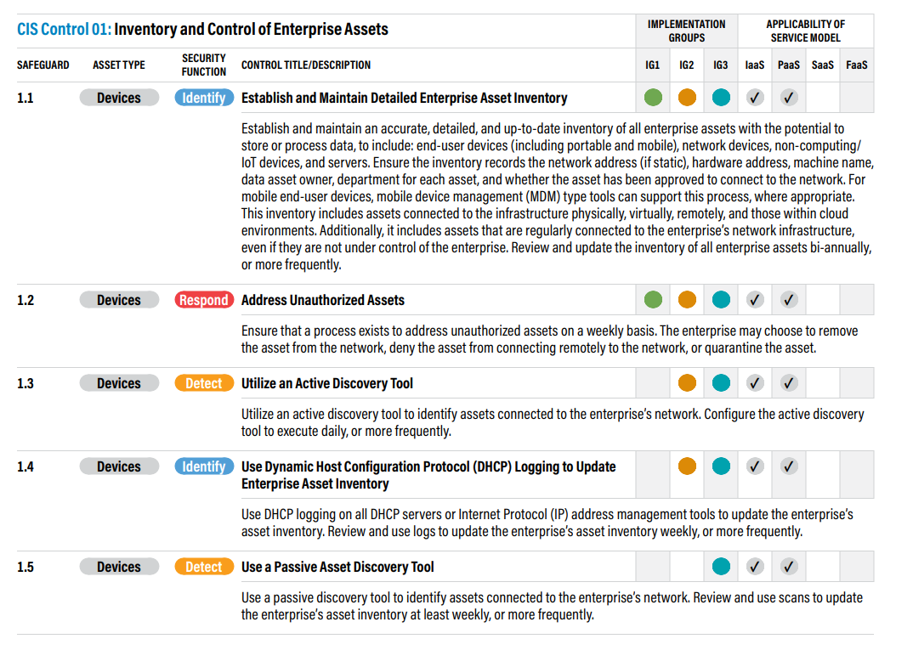
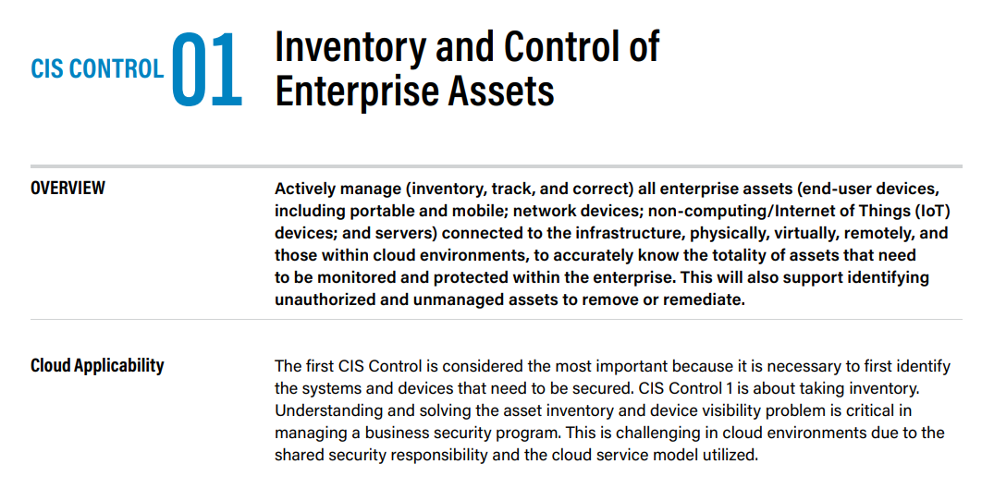
1: Inventory and control of hardware assets

Slide 22
1: Inventory and control of hardware assets
How are users accessing resources today? On what devices?
Do users access data on their personal devices?
Is important company data being accessed on personal devices?
How do you protect that data if that device is lost or stolen?
How do you prevent infected devices from joining your network?

Slide 23
What are the risks being raised by this control?
Unmanaged device brings malware to corporate network
Unmanaged device with corporate data is lost or stolen
Unmanaged device encrypts corporate documents with ransomware
Employee leaves with sensitive data on personal device

Slide 24
What are my recommended baseline safeguards?
Gather a list of all hardware devices that the company manages
Determine what device platforms you will manage (Windows, iOS, macOS, Android)
Enrol devices in Intune
Create a device compliance policy for each platform
Create a conditional access policy that grants access to corporate resources when the device is in a compliant state
Prevent access to your corporate network by unmanaged or unhealthy devices
Create an App Protection Policy for iOS and Android to manage applications on unmanaged devices

Slide 25
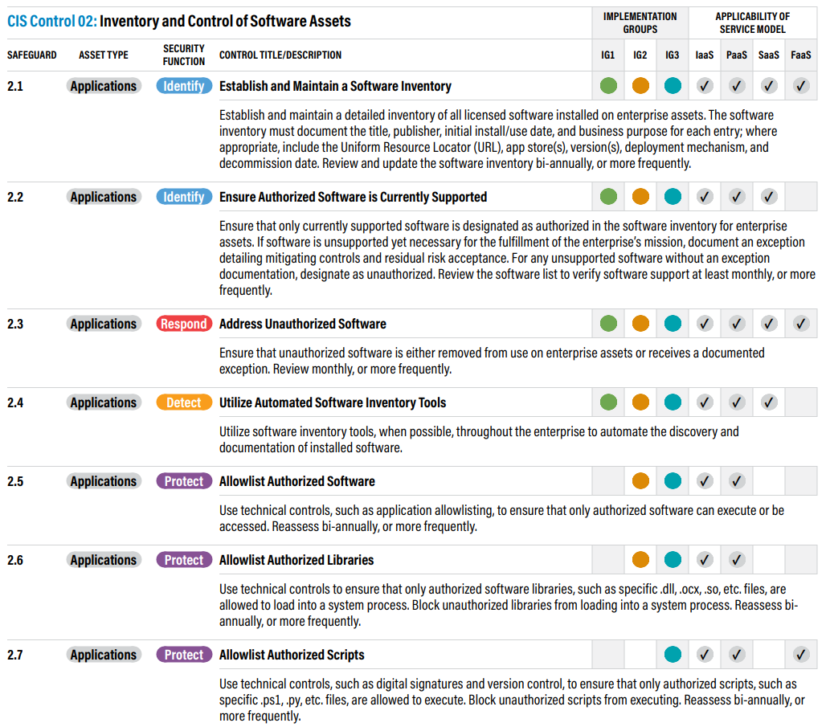
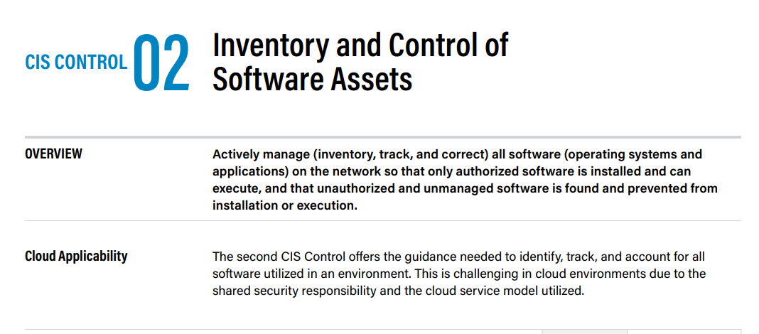
2: Inventory and control of software assets

Slide 26
2: Inventory and control of software assets
Which applications do users access across the company?
Are users transferring corporate data to unmanaged applications?
Do users access applications with corporate data on their personal devices?
How do you protect application data if a personal device is lost or stolen?
How do you know when a new application for the company has been onboarded?
What does your application management lifecycle look like today?

Slide 27
What are the risks being raised by this control?
Software vulnerability causes unmanaged device to get infected
Data loss to unmanaged application
Infected device encrypts sensitive corporate documents with ransomware
Employee leaves with sensitive data on personal device
Shadow IT prevents you from effectively securing access to company assets

Slide 28
What are my recommended baseline safeguards?
Perform an asset inventory checklist and determine what apps are authorized to access corporate data
Add applications to Azure Active Directory for single sign-on access
Enrol devices in Intune
Set up device compliance policies for every device you are going to support
Set up app protection policies for Windows, iOS, and Android
Push out managed applications to managed devices with Intune
Set up a conditional access policy for policy-managed apps. Only grant access to applications such as the Office suite if they are using a client approved app
Remove users’ ability to register an app in Azure Active Directory

Slide 29
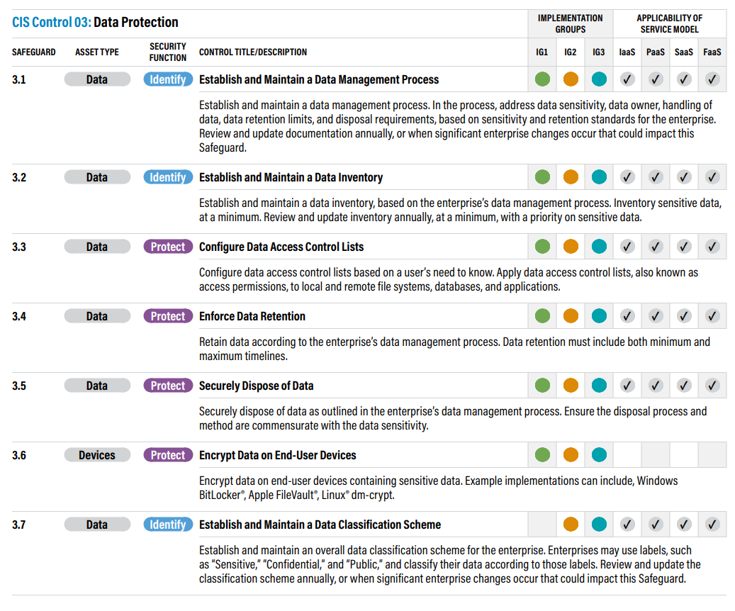
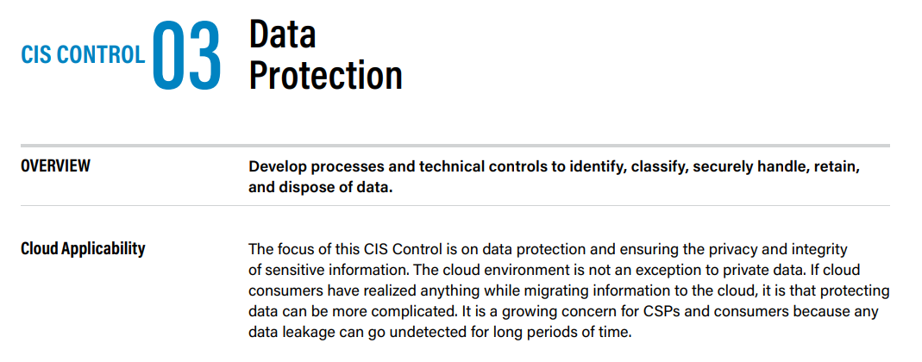
3: Data protection

Slide 30
3: Data protection
What applications or portals are employees using to access corporate data?
Where is sensitive data stored today?
How do you classify sensitive data?
Are users accessing corporate data from personal devices?
What would be the cost to the company if sensitive data was leaked?
What safeguards do you have in place to prevent accidental deletion of sensitive information?
Do users access email through their personal devices?
If a user leaves, how do you know they don’t have corporate data stored on their personal device?
Are there business-critical pieces of data that would leave you exposed if a personal device was compromised?
Are you compliant if data is leaked to unmanaged applications?
Do employees have access to corporate apps after they leave the company? How do you know whether they do or not?
Can you remotely wipe corporate data when someone leaves or if their device is lost or stolen?

Slide 31
What are the risks being raised by this control?
Sensitive information is being shared internal or externally without your knowledge
Sensitive information is being shared in an insecure manner outside the organization
Sensitive information is being saved in unmanaged locations
Sensitive information is being sent in an insecure manner due to human error
Sensitive information is not retained or archived properly
Sensitive information is being accessed insecurely on unmanaged devices
You are unable to place a litigation hold on users’ information and that information is deleted

Slide 32
What are my recommended baseline safeguards?
Determine where data is stored and define classification labels for sensitive information
Determine what sensitive information is being shared internally and externally
Create Azure Information Protection labels and define custom policies for access, retention, encryption, and sharing permissions
Create a data loss prevention policy
Create a conditional access policy to prevent access to unmanaged client applications when a user is not on your network or is using an unmanaged device
Create a conditional access policy to block access to certain applications with highly critical business data when a user is trying to access them from an unmanaged device
Review the default retention policies and customize them for business needs

Slide 33
Configuration implementation and management
Infrastructure as code (IAC) is a practice that involves defining and managing infrastructure in a declarative manner, using code and automation tools. This approach offers several benefits, including:
Version control: IAC enables the use of version control systems such as Git, which allows for tracking and auditing of infrastructure changes.
Repeatability: With IAC, the infrastructure can be easily reproduced and deployed across multiple environments, ensuring consistency and reducing the risk of errors.
Collaboration: IAC allows teams to work collaboratively on infrastructure projects, enabling them to share, review, and approve changes before they are applied.
Scalability: IAC enables infrastructure to be easily scaled up or down based on changing business needs, without the need for manual intervention.
Reliability: IAC ensures that infrastructure is consistently configured and deployed in a predictable manner, reducing the risk of errors and downtime.
Cost savings: IAC enables the use of automation and programmatic approaches to manage infrastructure, which can lead to significant cost savings.
Overall, IAC provides a more efficient and effective way to manage and maintain infrastructure, enabling organizations to reduce costs, improve reliability, and accelerate development.

Slide 34
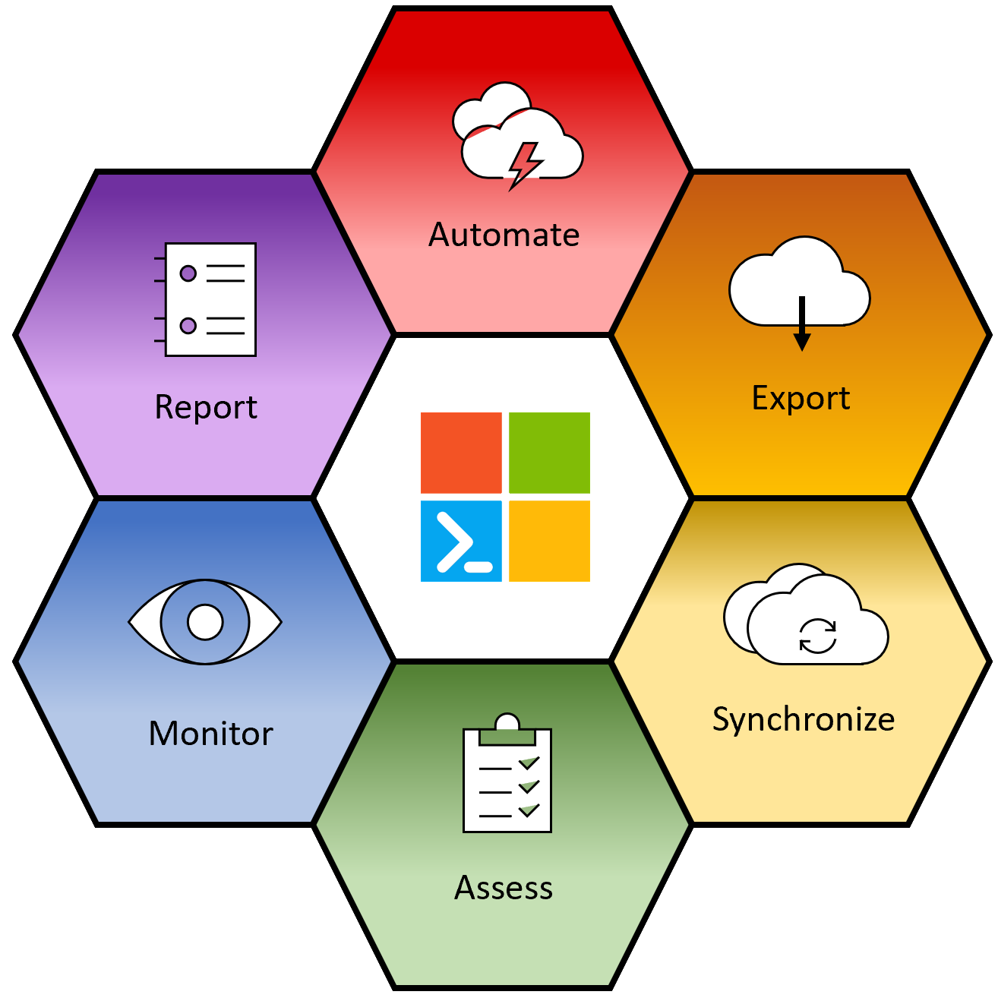
Microsoft 365 DSC tenant configuration management
To Ensure that the configuration that’s established and put in place remains stable, deploying configuration changes as code within the tenant will be implemented to allow for the tenant to be controlled and managed through DevOps pipelines, this will enforce good governance and deployment practice through the established CCOE processes.
When deployed through Azure DevOps, we can use configuration as code to track changes made by service administrators and add an approval process to deployments.
Configuration as code can help you prevent untracked changes to Microsoft 365 tenants which helps to prevent configuration drift.

Slide 35
A layered approach to design

Slide 36
Finalisation
We now have all of our components captured, mapped and documented for our design. With these components you should be able to begin your implementation of a modern workplace approach which follows good practice, is risk aware and is sustainable going forward.
This is the beginning of the design lifecycle, more organisational challenges and use cases will appear after your have implemented your design, make sure that they are documented and captured and integrate into your baseline design so that the same consistency can be applied in the future.

Slide 37
Questions?

Slide 38
Contact me:
Email: walter.fraser@reply.com
Twitter (if it’s still working): @VS_Affro

